Slide 1
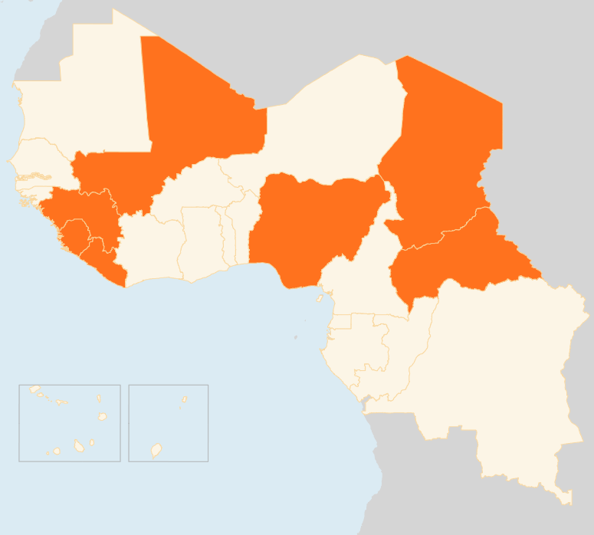


28 July – 3 August 2015
CENTRAL AFRICAN REPUBLIC
Clashes continue IN THE NORTH
At least 26 people died on 28 July as armed groups clashed over control of Markounda, a town in the northwest of the Central African Republic.
1 peacekeeper killed
On 2 August, a UN peacekeeper with MINUSCA was shot and killed during clashes with armed assailants in a Northern neighbourhood of the capital, Bangui. The attack was condemned by the United Nations Secretary-General Ban Ki-moon.
CHAD
Nearly 26,000 Internally Displaced reported in the Lake region
Significant spontaneous displacements due to the threat of Boko Haram and / or military operations and clashes with assailants have been reported in the Lake region, bringing the number of new displaced people over the last 2 weeks to nearly 26,000 in the Lake Chad area. Several inter-agency evaluation missions have been undertaken to the sites where the IDPs are located. Most important needs reported are shelter, food, WASH and health. The humanitarian response has begun for about 2,000 people in three sites where NFI and WASH kits have been distributed by WFP and UNICEF. An inter-agency coordination meeting was organized on 31 July to plan and coordinate the response to these new arrivals.
MALI
12 killed in attacks
Gunmen killed 10 Malian soldiers at the Gourma Rharous military base in the northern region of Timbuktu on 3 August, an army official said. Two soldiers were also killed on 1 August when they were ambushed in an area close to the country's border with Mauritania. In the wake of the attacks, MINUSMA stressed the urgent need to advance the peace process to ensure that the Government and the stakeholders work and act together, with the support of the population, to ward off the terrorist threat in Mali.
NIGERIA
178 hostages freed from Boko Haram
Boko Haram attacks continue in northern Nigeria where 13 people were killed on 2 August during a raid on Malari village in Borno state. Media reports indicate that homes and other structures were burned or otherwise destroyed during the attack. On 3 August, Nigeria's military said they attacked a Boko Haram base and set free 178 hostages, mainly women and children, near Aulari, about 70 kilometres south of Maiduguri.
EVD REGIONAL
UNMEER closed on 31 July
Secretary-General Ban Ki-moon informed on the closure of UNMEER from 31 July and that the UN’s Ebola emergency response will transition from UNMEER to WHO under the direct authority of the WHO Director-General. As of 3 August, there are two new confirmed cases of Ebola virus disease (EVD): one in Guinea and one in Sierra Leone. This is the lowest weekly total for over a year. 3 August marked day 10 of the 2nd 42 day countdown to an Ebola-free Liberia.
MALI
CHAD
12
KILLED IN ATTACKS
26k
NEW IDPs IN LAKE REGION
NIGERIA
178
HOSTAGES FREED
CAR
1
PEACEKEEPER KILLED
EVD REGIONAL
UNMEER CLOSED ON 31 JULY
Creation date: 04 August 2015
Map data sources: UNCS, DevInfo, OCHA.
The boundaries and names shown and the designations used on this map do not imply official endorsement or acceptance by the United Nations

